Slide 1
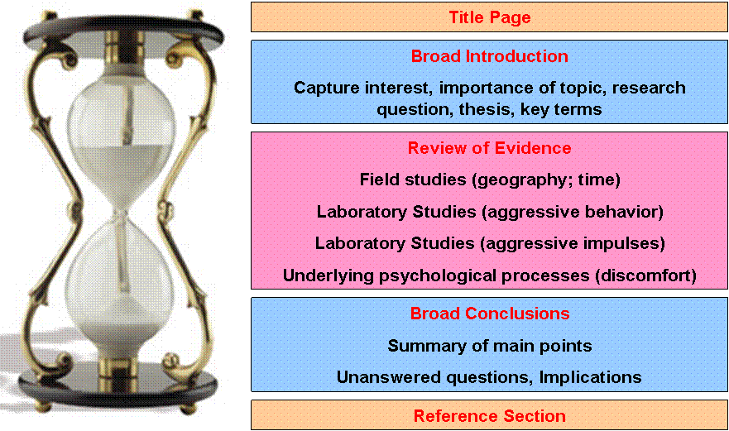
Dissecting A Literature Review
Psychology 100W
Instructor: Jason X. Ventura

Slide 2
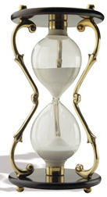
Dissecting a Literature Review Anderson (2001)
Title Page
Broad Introduction
Capture interest, importance of topic, research question, thesis, key terms
Review of Evidence
Field studies (geography; time)
Laboratory Studies (aggressive behavior)
Laboratory Studies (aggressive impulses)
Underlying psychological processes (discomfort)
Broad Conclusions
Summary of main points
Unanswered questions, Implications
Reference Section
Notes:
What are the purposes of the first two paragraphs of the article? What information is being conveyed?
Captures interest
Research question
Highlights what has been done before and why modern empirical studies were needed to test the heat hypothesis.
Defines key terms
NOTE: research question is appropriately narrow. Not concerned with ALL the possible cause of aggressive behavior. Focuses on a single aspect: heat.
What is the general organization of the middle section of the article (pp. 33, beginning with “Modern Studies of the Heat Hypothesis” – 36)? How are these related to the thesis?
Reviews evidence of heat hypothesis in a variety of settings (i.e., field studies). Within this topic, further subdivides into geography studies and time studies. Contrasts heat hypothesis evidence with competing explanations.
Reviews experimental evidence testing the heat hypothesis.
Review experimental studies that focus on aggressive impulses (vs. aggressive behaviors).
Describes possible reason why heat causes aggressive behavior (discomfort).
Why is author’s organization effective?
correlational: geography (field studies) ➔ correlational: time (field studies) ➔ experimental (lab studies) ➔ Underlying psychological processes
Establishes association of heat and violence in a variety of contexts ➔ Becomes more specific by focusing on work aimed at testing a causal relationship ➔ once heat hypothesis is established, can talk about why the heat and violence are causally linked.
Question: could have organized differently.
Why not chronological? Would not be organized around specific subtopics.
Why not Underlying psychological processes ➔ correlational: geography (field studies) ➔ experimental (lab studies) ➔ correlational: time (field studies)?
Does not flow neatly. Ideas jumping all around.
What are the purposes of the last few paragraphs of the article (pp. 36 – 37)?
Summarize main points
Highlight what we still don’t know
Highlight implications: why does this body of research establishing the heat hypothesis matter?

Slide 3
Question #2
Good introductions typically (a) capture your attention, (b) introduce and define key concepts, (c) presents the central thesis of the paper, and perhaps (d) outlines major topics in the rest of the article.
To what extent did your article address each of these elements?

Slide 4
Purposes of the first two paragraphs of the article?
What information is being conveyed?
Captures interest
Research question
Highlights what has been done before and why modern empirical studies were needed to test the heat hypothesis.
Defines key terms

Slide 5
Reviews evidence of heat hypothesis in a variety of settings (i.e., field studies).
Reviews experimental evidence testing the heat hypothesis.
Review experimental studies that focus on aggressive impulses (vs. aggressive behaviors).
Describes possible reason why heat causes aggressive behavior (discomfort).

Slide 6
Question #3
A good topic sentence should summarize the main point or claim of the paragraph, and can also serve to transition from the preceding paragraph.
Select a paragraph from your article that has all these elements and describe the structure of the paragraph.

Slide 7
Topic sentence
Generally, the topic sentence appears at the beginning of the paragraph. It is often the paragraph’s very first sentence.

Slide 8
Topic sentence (cont.)
A paragraph’s topic sentence must be general enough to express the paragraph’s overall subject.
But it should be specific enough that the reader can understand the paragraph’s main subject and point.

Slide 9
Question #4
Good conclusions typically (a) summarize the main points of the article, (b) highlight what is known and also gaps in our knowledge, and perhaps (c) suggest future avenues for research. To what extent did your article address each of these elements?
Notes:
You are finished. Done. Complete. Don't try to bring in new points …Simplicity is best for a clear, convincing message..

Slide 10
Conclusion
Restate your topic and why it is important,
Restate your thesis/claim,
Address opposing viewpoints and explain why readers should align with your position,
Call for action or overview future research possibilities.

Slide 11
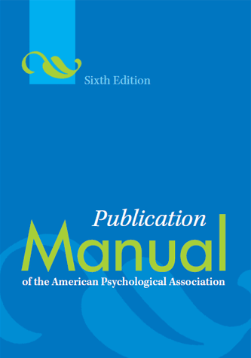
What is APA Style? Why do we need it?
What?
Standard rules used by psychologists
Emphasis: clear communication
Why?
Standardized communication
Specific needs of scientific psychology
Efficient information processing
Improves writing
Notes:
Now, answer these questions again. Answer, to the best of your knowledge, the following questions on a sheet of paper. Please write clearly, legibly.
What is APA style?
Why do we need APA style?
Read APA Manual p. xiii
What is APA style?
The standard rules, conventions, and guidelines used by psychologists (including psychology majors) when doing academic writing: class papers to theses and dissertations to professional manuscripts.
First developed in 1928. Has changed over time.
Emphasis on clear communication:
Orderly presentation of ideas…logical organization
Clarity and precision…using the correct words
Directness and economy of expression…versus using a lot flowery phrases
Tone…professional versus casual, chatty
Why do we need APA style?
Enable psychologists to communicate with one another in a standard way:
No surprises. No distractions.
We need to know what to expect from an article or paper:
where to find certain kinds of information.
How information is presented.
Need a style that meets the need of scientific psychology and its practitioners:
How to describe research, methodology, statistical results, interpretations of results in a consistent way.
e.g., Statistical results not needed by english majors.
Need a style that helps psychologists efficiently process scientific information:
Need consistent, standard ways of writing
Standard must convey scientific information (hypotheses, etc.) efficiently
Improves writing
By following guidelines, our writing becomes more clear, concise, persuasive.
GO OVER GENERAL FORMAT OF APA MANUAL
Section # vs. page numbers
Most relevant for 100W

Slide 12
Basic Elements of APA Style In-text Citations (APA 3.94 – 3.103) Headings (APA 3.30 – 3. 32)
Emphasize concept
Self-monitoring is a personality trait concerned with individual differences in the ability and motivation to regulate expressive behaviors in response to the social environment (Snyder, 1974).
Highlights the Researcher (e.g., p. 36, Craig, 2001)
Snyder (1974) proposed the construct of self-monitoring: individual differences in the ability and motivation to regulate expressive behaviors in response to the social environment
Headings
Conveys organization of article
Designates major sections, subsections
Notes:
There are two ways that the author references other work in the text of the article. What are they?
APA Manual 3.94 – 3.103
Emphasize concept
Self-monitoring is a personality trait concerned with individual differences in the ability and motivation to regulate expressive behaviors in response to the social environment (Snyder, 1974; Snyder, 1987).
Highlights the Researcher (e.g., p. 36, Craig, 2001)
Snyder (1974) proposed the construct of self-monitoring: individual differences in the ability and motivation to regulate expressive behaviors in response to the social environment
Notice the headings used in the article. What is the purpose of these headings?
Tells reader quickly the general organization of the article and allows reader to skim and find information quickly
Tells reader major sections (e.g., Modern studies), subsections (e.g., Field studies)

Slide 13
Abstract
150-250 word range
No indentation
Keywords after the last sentence (indented; provide 3-4 keywords; italicize the word “Keywords;” do not italicize keywords)

Slide 14
Abstract contains:
Objective
Method
Results
Conclusion (including limitations and “future research suggests…”

Slide 15
Literature Review 100W
Similarities
Pose and answer research question on a topic
Review empirical studies
Similar organization
APA Style
Differences
Manuscript form
Describe studies in more detail
Notes:
Summary
Literature reviews tell us what we know about a particular topic. Raise a question provides an answer to the question based on empirical studies.
Heart of the literature review are descriptions, interpretations, and evaluations of research related to the topic.

