Slide 1
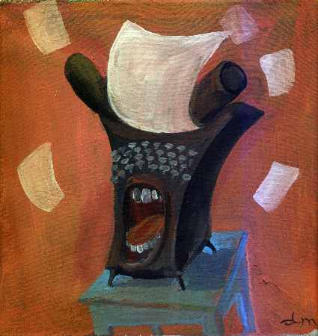
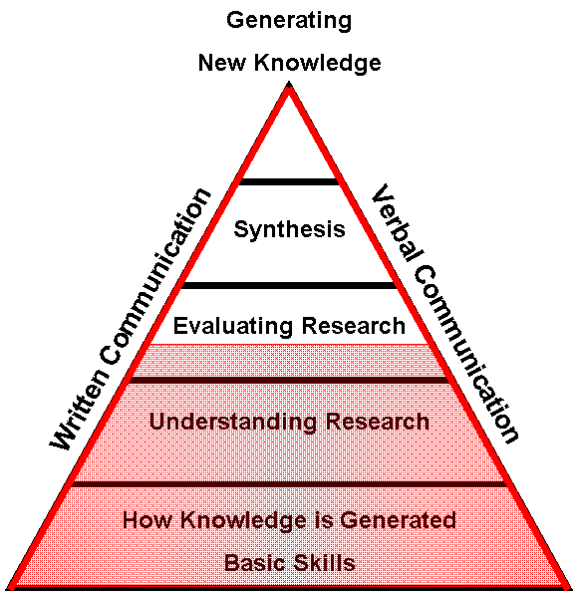
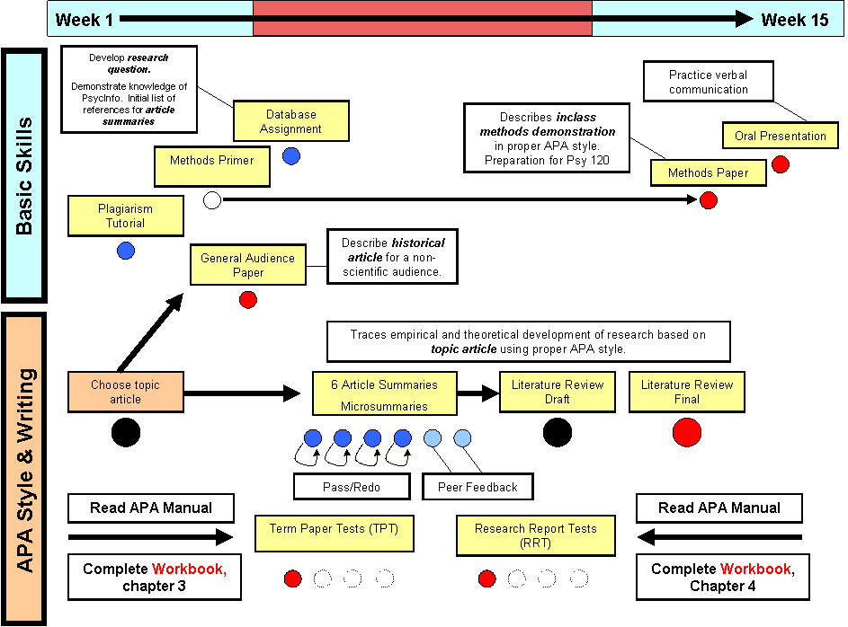
Psychology 100W Writing Workshop
Instructor: Jason X. Ventura

Slide 2
Today
Evaluating Information Sources
APA Style Basics

Slide 3
The Evidence for “Grit”
TED Talk: Intelligence vs. “Grit”
What is the main claim of the presenter?
Should we believe the claim?
What evidence is provided and how credible is it?
Is it anecdotal? Empirical? Quantitative? Qualitative? Experiments? Correlational studies?
Do a web search on the concept presented. What kinds of sources are you finding? How credible are these sources?
Do a web search on the author. What are her qualifications?

Slide 4
The Evidence for “Grit”
TED Talk: Intelligence vs. “Grit”
Angela Lee Duckworth
University of Pennsylvania
The Duckworth Lab
Grit: Perseverance and Passion for Long-Term Goals

Slide 5
The Evidence Against “Grit”?
The problem with teaching “grit” to poor kids? They already have it.
Much Ado About Grit

